Slide 1
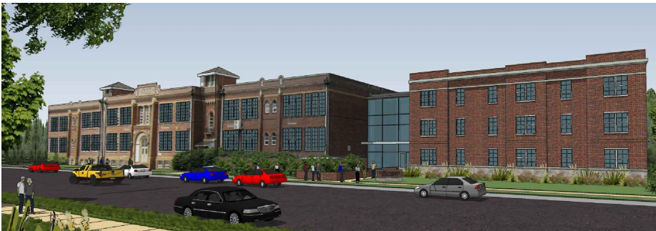
The Duffy School addition & renovation
Penn State AE
Senior Capstone Project
Jeremy Drummond
Construction Option
Advisor: anumba
April 14th, 2014
**Rendering of building supplied by Gary Gardner with Owner Permission

Slide 2
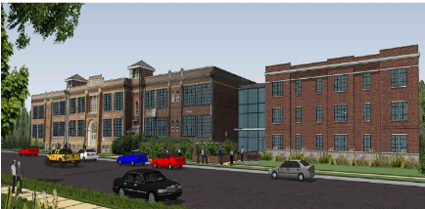
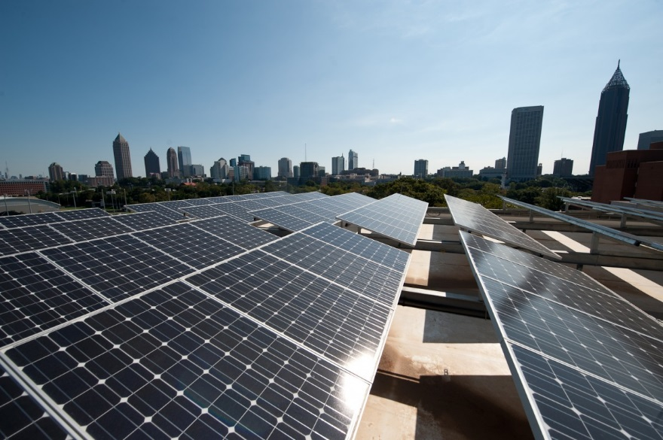
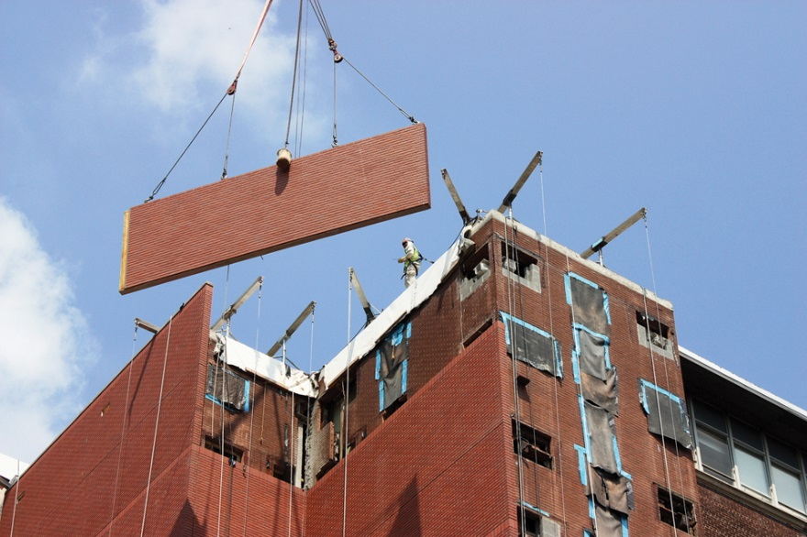
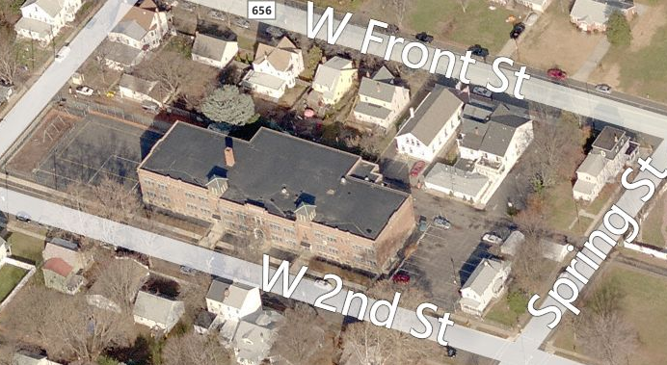
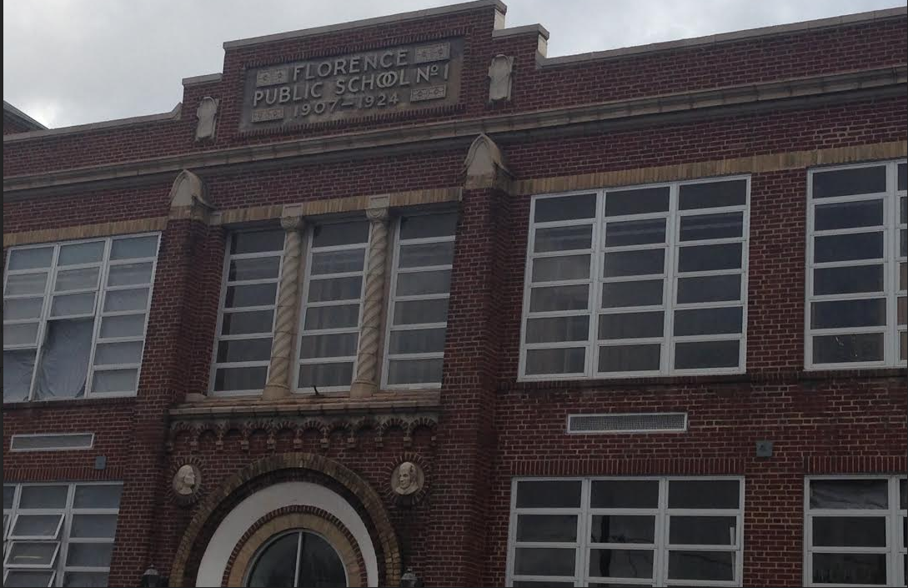
Introduction
The Duffy School
Addition & Renovation
Jeremy Drummond│ Construction Option
`
Presentation Outline:
I. Introduction
II. Project Overview
III. Analysis #1: Rooftop Solar Panels
In-Place vs. Virtual Mockups
Virtual Mockup Development
Virtual Mockup Implementation
Conclusion & Recommendation
IV. Analysis #2: Façade Prefabrication
Current vs. Prefabricated Façade
Mechanical Breadth Analysis
Schedule, Cost & Site Logistics
Conclusion & Recommendations
V. Analysis #3: Revaluating Composite Slab
Lightweight vs. Normal Concrete
Structural Breadth Analysis
Project Impacts
Conclusion & Recommendations
VI. Final Recommendations
VII. Acknowledgements
Presentation Outline:
I. Introduction
II. Project Overview
III. Analysis #1: Rooftop Solar Panels
IV. Analysis #2: Historical Requirements
V. Analysis #3: Prefab Exterior Walls
VI. Final Recommendations
VII. Acknowledgements
Analysis 1 │ Rooftop Solar Panels
Analysis 3 │Prefabricated Exterior Wall Panels
Project Overview
Analysis 2 │Historical Requirements
http://www.solar.excluss.com/solar-equipment/solar-panels/
http://cptmfg.com/portfolio/pews.php
Googlemaps.com
Taken by Jeremy Drummond
April 14, 2015

Slide 3
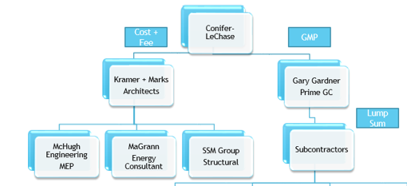
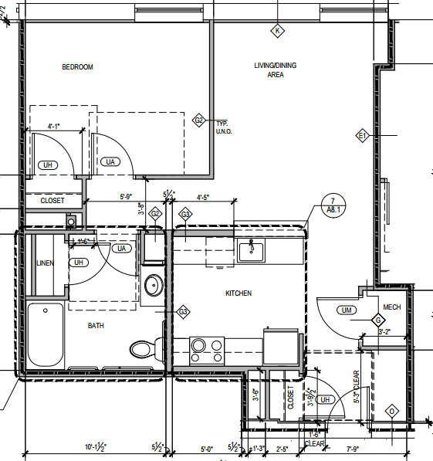
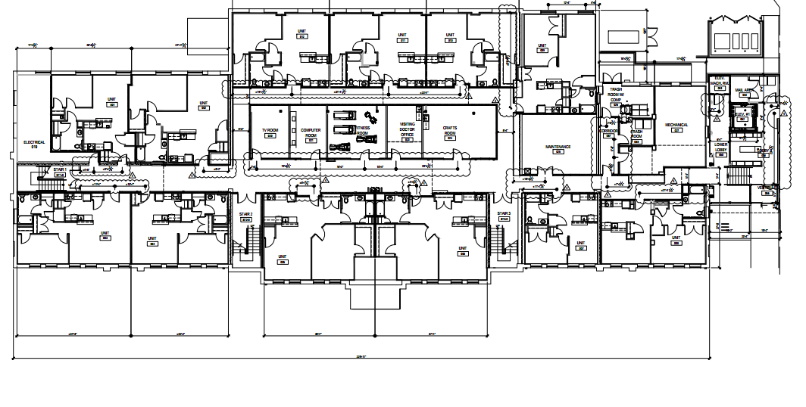
Project Background
The Duffy School
Addition & Renovation
Jeremy Drummond │ Construction Option
Presentation Outline:
I. Introduction
II. Project Overview
III. Analysis #1: Virtual Mockups
In-Place vs. Virtual Mockups
Virtual Mockup Development
Virtual Mockup Implementation
Conclusion & Recommendation
IV. Analysis #2: Façade Prefabrication
Current vs. Prefabricated Façade
Mechanical Breadth Analysis
Schedule, Cost & Site Logistics
Conclusion & Recommendations
V. Analysis #3: Revaluating Composite Slab
Lightweight vs. Normal Concrete
Structural Breadth Analysis
Project Impacts
Conclusion & Recommendations
VI. Final Recommendations
VII. Acknowledgements
Presentation Outline:
I. Introduction
II. Project Overview
Project Background
III. Analysis #1: Rooftop Solar Panels
IV. Analysis #2: Historical Requirements
V. Analysis #3: Prefab Exterior Walls
VI. Final Recommendations
VII. Acknowledgements
Building History:
Marcella. L Duffy School 1870
Expansion 1950
Closed 2008
General Building Information
Building Name | The Duffy School Addition and Renovation
Location | Florence, NJ
Function | Residential
Size | 70,593 GSF
Height | 3 Stories
Cost | $9.3 Million GMP
Construction | April ‘14- April '15
Delivery | Design-Bid-Build
Building Use:
Affordable Senior Citizen Apartments
53 New Units
Gym, Entertainment Center, Library, Doctors Office, Kitchen, Etc.
April 14, 2015
Notes:
4 classroom school in 1870
Addition in 1950s to k-8
Closed in 2008 due to high cost of hvac

Slide 4
The Duffy School
Addition & Renovation
Jeremy Drummond│ Construction Option
Presentation Outline:
I. Introduction
II. Project Overview
III. Analysis #1: Virtual Mockups
In-Place vs. Virtual Mockups
Virtual Mockup Development
Virtual Mockup Implementation
Conclusion & Recommendation
IV. Analysis #2: Façade Prefabrication
Current vs. Prefabricated Façade
Mechanical Breadth Analysis
Schedule, Cost & Site Logistics
Conclusion & Recommendations
V. Analysis #3: Revaluating Composite Slab
Lightweight vs. Normal Concrete
Structural Breadth Analysis
Project Impacts
Conclusion & Recommendations
VI. Final Recommendations
VII. Acknowledgements
Presentation Outline:
I. Introduction
II. Project Overview
III. Analysis #1: Rooftop Solar Panels
Problem Identification
Components
Feasibility Analysis
Electrical Breadth
Implementation & Recommendation
IV. Analysis #2: Historical Requirements
V. Analysis #3: Prefab Exterior Walls
VI. Final Recommendations
VII. Acknowledgements
Analysis #1
Implementing Rooftop Solar Panels
April 14, 2015

Slide 5
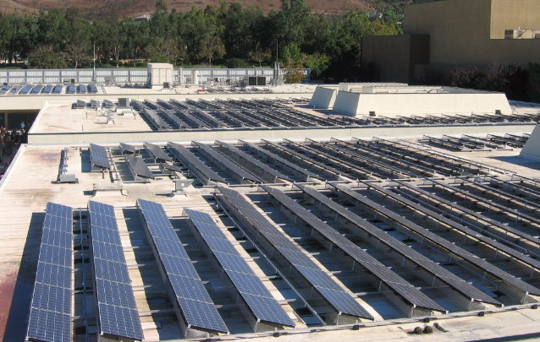
Energy Costs
The Duffy School
Addition & Renovation
Jeremy Drummond │ Construction Option
Presentation Outline:
I. Introduction
II. Project Overview
III. Analysis #1: Virtual Mockups
In-Place vs. Virtual Mockups
Virtual Mockup Development
Virtual Mockup Implementation
Conclusion & Recommendation
IV. Analysis #2: Façade Prefabrication
Current vs. Prefabricated Façade
Mechanical Breadth Analysis
Schedule, Cost & Site Logistics
Conclusion & Recommendations
V. Analysis #3: Revaluating Composite Slab
Lightweight vs. Normal Concrete
Structural Breadth Analysis
Project Impacts
Conclusion & Recommendations
VI. Final Recommendations
VII. Acknowledgements
Presentation Outline:
I. Introduction
II. Project Overview
III. Analysis #1: Virtual Mockups
Problem Identification
Components
Feasibility Analysis
Electrical Breadth
Implementation & Recommendation
IV. Analysis #2: Historical Requirements
V. Analysis #3: Prefab Exterior Walls
VI. Final Recommendations
VII. Acknowledgements
Problem Identification:
Affordable Apartments
Apartment Amenities
Payment Method?
Proposed Solution:
Rooftop Solar Panels
Research Goal:
Different types of photovoltaic systems
Sunlight Properties
Cost vs. Schedule
http://www.solar.excluss.com/solar-equipment/solar-panels/
April 14, 2015
Notes:
7 apts for 30% below medium income
20 for 50%
21 for 60%
5 for homeless

Slide 6
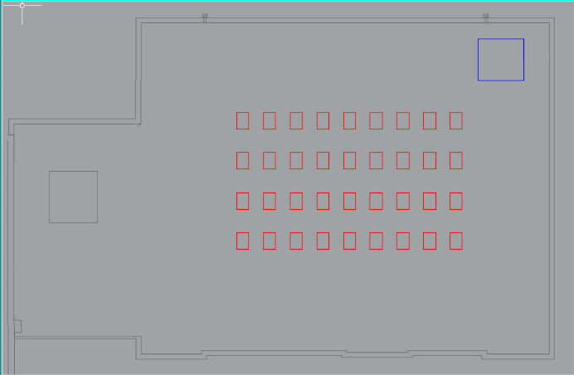
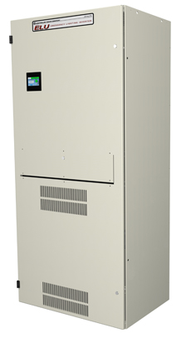
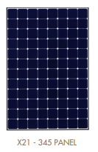
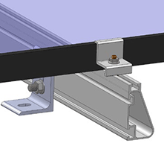
Solar Panel Components
The Duffy School
Addition & Renovation
Jeremy Drummond │ Construction Option
Presentation Outline:
I. Introduction
II. Project Overview
III. Analysis #1: Virtual Mockups
In-Place vs. Virtual Mockups
Virtual Mockup Development
Virtual Mockup Implementation
Conclusion & Recommendation
IV. Analysis #2: Façade Prefabrication
Current vs. Prefabricated Façade
Mechanical Breadth Analysis
Schedule, Cost & Site Logistics
Conclusion & Recommendations
V. Analysis #3: Revaluating Composite Slab
Lightweight vs. Normal Concrete
Structural Breadth Analysis
Project Impacts
Conclusion & Recommendations
VI. Final Recommendations
VII. Acknowledgements
Presentation Outline:
I. Introduction
II. Project Overview
III. Analysis #1: Virtual Mockups
Problem Identification
Components
Feasibility Analysis
Electrical Breadth
Implementation & Recommendation
IV. Analysis #2: Historical Requirements
V. Analysis #3: Prefab Exterior Walls
VI. Final Recommendations
VII. Acknowledgements
System:
Grid-tied system
4 rows of 9 panels (36 panels)
SunPower X21- 345 Panel
UltraLITE Model ELU14000 Centralized Inverter
IronRidge XR1000
Placement:
New Addition
EPDM Roof
Inverter Location
AC panel and utility tie in located in RM
Created by Jeremy Drummond
April 14, 2015

Slide 7
Feasibility Analysis
The Duffy School
Addition & Renovation
Jeremy Drummond │ Construction Option
Presentation Outline:
I. Introduction
II. Project Overview
III. Analysis #1: Virtual Mockups
In-Place vs. Virtual Mockups
Virtual Mockup Development
Virtual Mockup Implementation
Conclusion & Recommendation
IV. Analysis #2: Façade Prefabrication
Current vs. Prefabricated Façade
Mechanical Breadth Analysis
Schedule, Cost & Site Logistics
Conclusion & Recommendations
V. Analysis #3: Revaluating Composite Slab
Lightweight vs. Normal Concrete
Structural Breadth Analysis
Project Impacts
Conclusion & Recommendations
VI. Final Recommendations
VII. Acknowledgements
Presentation Outline:
I. Introduction
II. Project Overview
III. Analysis #1: Rooftop solar Panels
Problem Identification
Components
Feasibility Analysis
Electrical Breadth
Implementation & Recommendation
IV. Analysis #2: Historical Requirements
V. Analysis #3: Prefab Exterior Walls
VI. Final Recommendations
VII. Acknowledgements
Schedule:
Installation Process
Longest Task
Total- 18.5 Days
Solar Panel Installation
Item | Qty. | Unit | Hours | Total
Mount | 36 | Ea. | 1.25 | 45
Rack | 4 | Per 9 Mounts | 0.75 | 3
Solar Panels | 36 | Ea. | 1 | 36
Inverter | 1 | Ea. | 4 | 4
Circuit Breaker | 1 | Ea. | 1.5 | 1.5
#12 AWG | 20 | LF | 0.5 | 10
#8 AWG | 6 | LF | 0.5 | 3
3/4" Conduit | 1153 | LF | 0.03 | 34.6
1/2" Conduit | 42 | LF | 0.25 | 10.5
 |  |  |  | 147.6
Solar Panel Cost
Item | Cost | Qty. | Unit | Total Cost
Mount | $0.11 | 12420 | Watt | $1,366.20
Rack | $322.54 | 4 | Ea. | $1,290.16
Solar Panels | $426.25 | 36 | Ea. | $15,345.00
Inverter | $5,153.88 | 1 | Ea. | $5,153.88
Circuit Breaker | $912.05 | 1 | Ea. | $912.05
#12 AWG | $47.69 | 20 | LF | $953.80
#8 AWG | $89.23 | 6 | LF | $535.38
3/4" Conduit | $3.57 | 1153 | LF | $4,116.21
1/2" Conduit | $2.44 | 42 | LF | $102.48
Solar Panel Installation | $3.18 | 12420 | Watt | $39,495.60
 |  |  |  | $69,270.76
Cost:
Prices
Installation
Total- $69,270
April 14, 2015

Slide 8
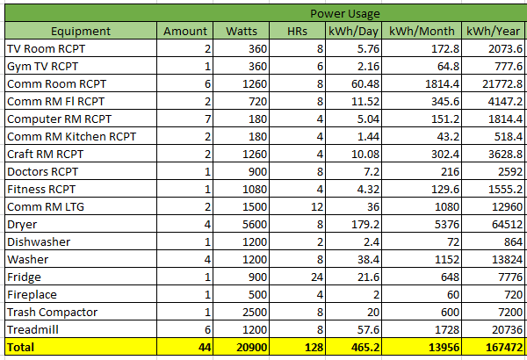
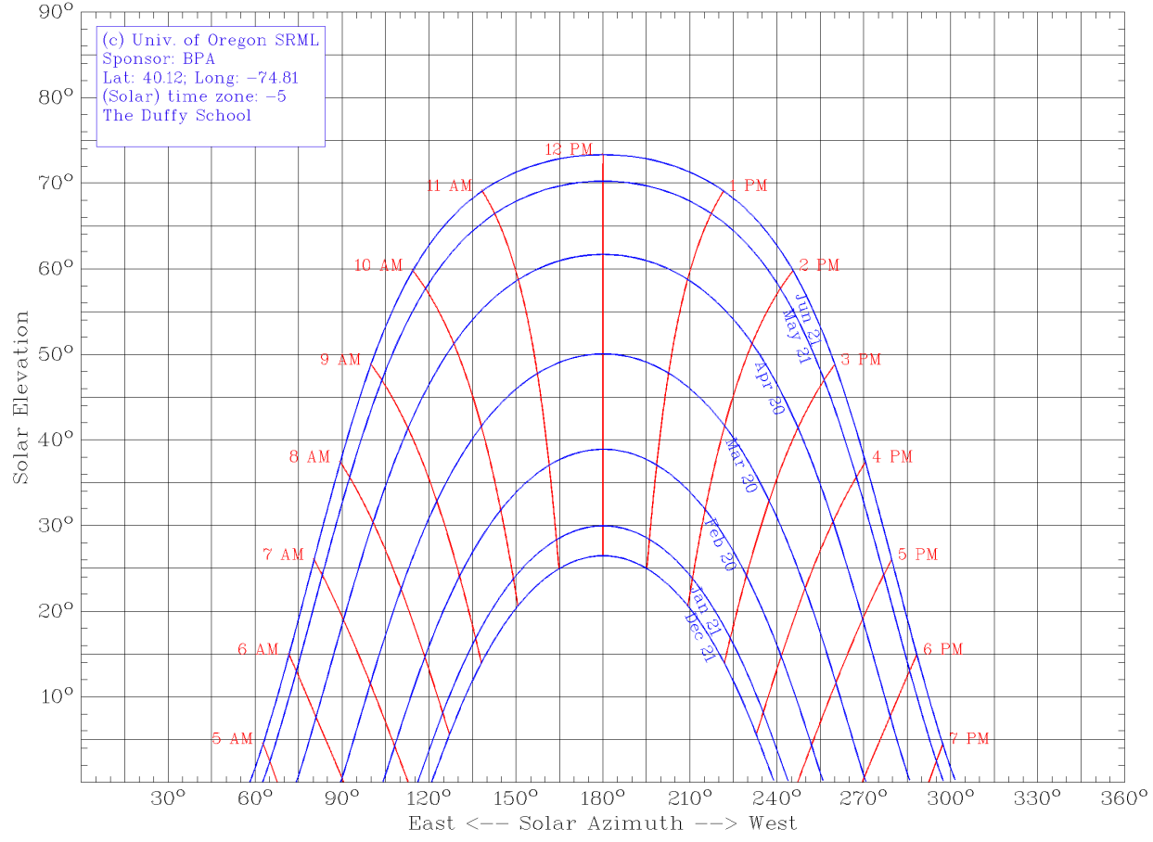
Electrical Breadth
The Duffy School
Addition & Renovation
Jeremy Drummond │ Construction Option
Presentation Outline:
I. Introduction
II. Project Overview
III. Analysis #1: Rooftop solar Panels
Problem Identification
Components
Feasibility Analysis
Electrical Breadth
Implementation & Recommendation
IV. Analysis #2: Historical Requirements
V. Analysis #3: Prefab Exterior Walls
VI. Final Recommendations
VII. Acknowledgements
Power Usage:
Receptacles
Lighting
Dryer
Washer
Refrigerator
Fireplace
Exercise Equipment
Shading:
April 14, 2015

Slide 9
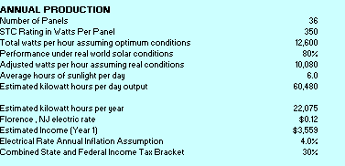
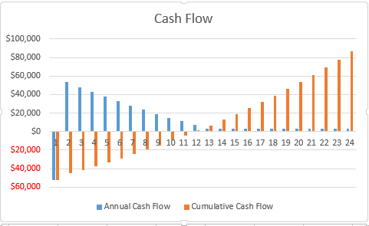
Electrical Breadth
The Duffy School
Addition & Renovation
Jeremy Drummond │ Construction Option
Payback Period:
Total Cost- $69,270
36 Panels
kWh
Electrical Rate
Federal Cash Incentive
Presentation Outline:
I. Introduction
II. Project Overview
III. Analysis #1: Rooftop solar Panels
Problem Identification
Components
Feasibility Analysis
Electrical Breadth
Implementation & Recommendation
IV. Analysis #2: Historical Requirements
V. Analysis #3: Prefab Exterior Walls
VI. Final Recommendations
VII. Acknowledgements
Payback Period:
Total Cost- $69,270
36 Panels
60480 kWh per day Output
Electrical Rate- $0.12
Payback Period:
Annual Energy Value- $3,559
Annual System Output-
11 Years
April 14, 2015

Slide 10
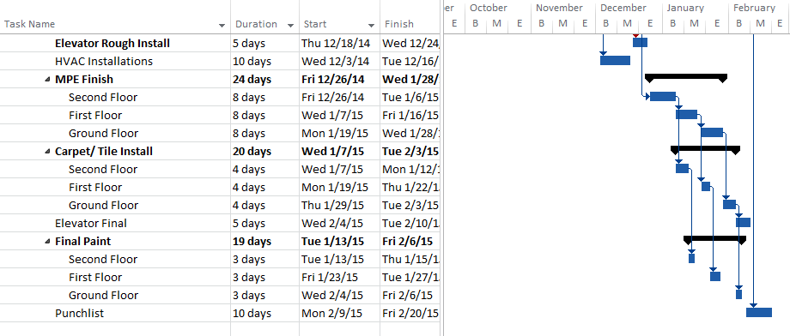
Solar Panel Implementation
The Duffy School
Addition & Renovation
Jeremy Drummond │ Construction Option
Presentation Outline:
I. Introduction
II. Project Overview
III. Analysis #1: Virtual Mockups
In-Place vs. Virtual Mockups
Virtual Mockup Development
Virtual Mockup Implementation
Conclusion & Recommendation
IV. Analysis #2: Façade Prefabrication
Current vs. Prefabricated Façade
Mechanical Breadth Analysis
Schedule, Cost & Site Logistics
Conclusion & Recommendations
V. Analysis #3: Revaluating Composite Slab
Lightweight vs. Normal Concrete
Structural Breadth Analysis
Project Impacts
Conclusion & Recommendations
VI. Final Recommendations
VII. Acknowledgements
Presentation Outline:
I. Introduction
II. Project Overview
III. Analysis #1: Rooftop Solar Panels
Problem Identification
Components
Feasibility Analysis
Electrical Breadth
Implementation & Recommendation
IV. Analysis #2: Historical Requirements
V. Analysis #3: Prefab Exterior Walls
VI. Final Recommendations
VII. Acknowledgements
Recommendation:
Implement Rooftop Solar Panels
Potential Value Added:
Occupant Satisfaction
Profit after 11 years
NJ Green Checklist
Schedule Impact:
18.5 Days
Schedule Implications:
Design Phase: Implement Early
Design-Review meetings between project participants & end users
Changes can be costly to implement later in the project lifecycle
Construction Phase: During interior finishes
Cost Impact:
$69,270
April 14, 2015

Slide 11
The Duffy School
Addition & Renovation
Jeremy Drummond │ Construction Option
Presentation Outline:
I. Introduction
II. Project Overview
III. Analysis #1: Virtual Mockups
In-Place vs. Virtual Mockups
Virtual Mockup Development
Virtual Mockup Implementation
Conclusion & Recommendation
IV. Analysis #2: Façade Prefabrication
Current vs. Prefabricated Façade
Mechanical Breadth Analysis
Schedule, Cost & Site Logistics
Conclusion & Recommendations
V. Analysis #3: Revaluating Composite Slab
Lightweight vs. Normal Concrete
Structural Breadth Analysis
Project Impacts
Conclusion & Recommendations
VI. Final Recommendations
VII. Acknowledgements
Presentation Outline:
I. Introduction
II. Project Overview
III. Analysis #1: rooftop solar panels
IV. Analysis #2: Historical Requirements
Current vs. Prefabricated Façade
Panel Design
Mechanical Breadth Analysis
Panel Implementation
Conclusion & Recommendations
V. Analysis #3: prefab exterior Walls
VI. Final Recommendations
VII. Acknowledgements
Analysis #2
Historical Requirements
April 14, 2015

Slide 12
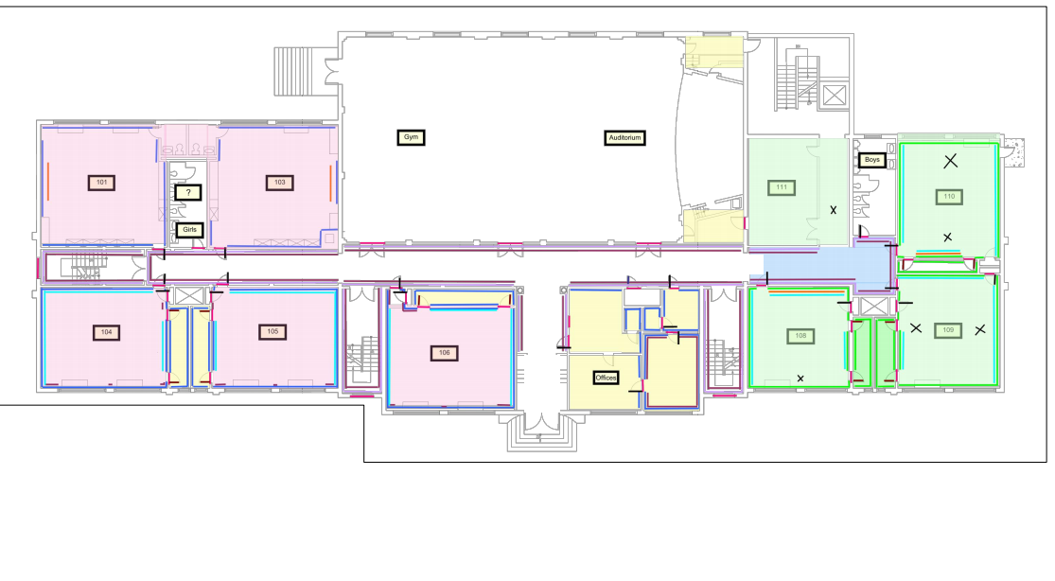
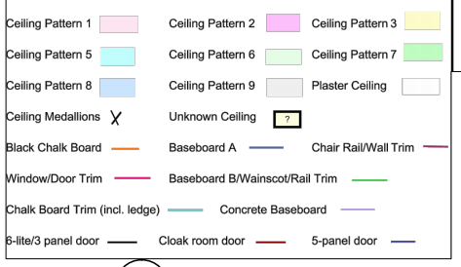
Requirements
The Duffy School
Addition & Renovation
Jeremy Drummond │ Construction Option
Presentation Outline:
I. Introduction
II. Project Overview
III. Analysis #1: rooftop solar panels
IV. Analysis #2: Historical Requirements
Requirements
Historical Consultant
Conclusion & Recommendations
V. Analysis #3: prefab exterior Walls
VI. Final Recommendations
VII. Acknowledgements
Requirements:
Chalkboards
Trim
Tin Ceilings
Border
Panels
Provided by Gary Gardner Construction
Provided by Gary Gardner Construction
April 14, 2015

Slide 13
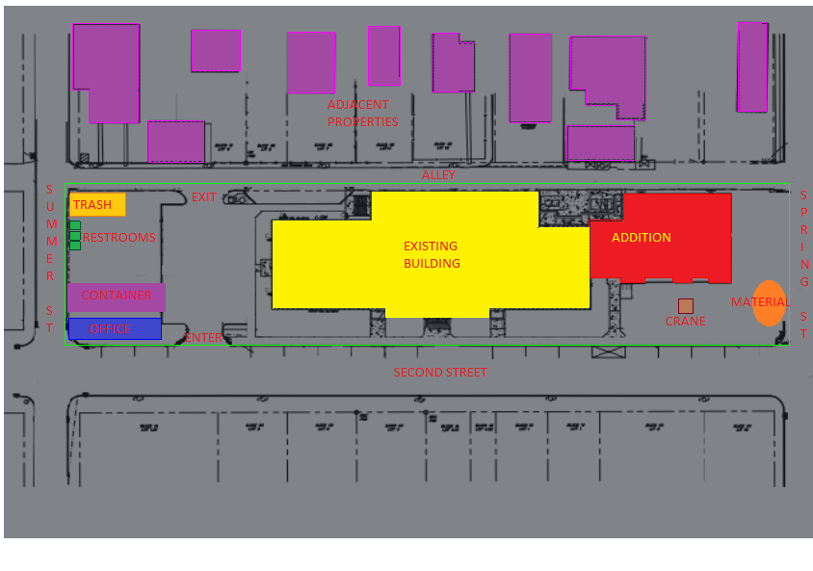
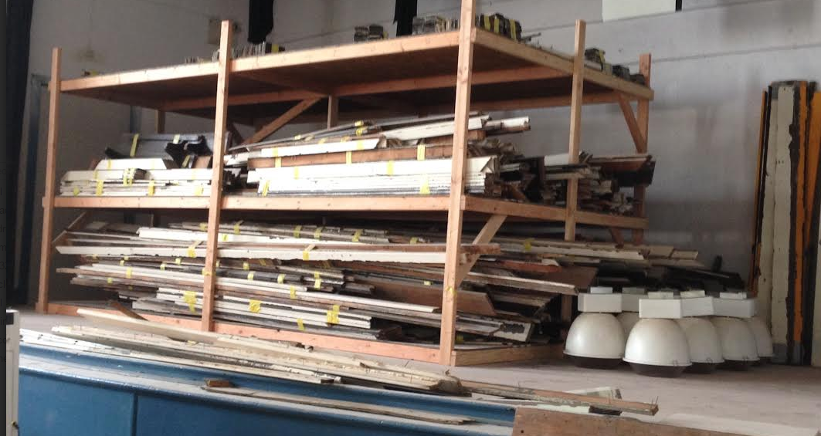
Historical Consultant
The Duffy School
Addition & Renovation
Jeremy Drummond │ Construction Option
Presentation Outline:
I. Introduction
II. Project Overview
III. Analysis #1: rooftop solar panels
IV. Analysis #2: Historical Requirements
Requirements
Historical consultant
Conclusion & Recommendations
V. Analysis #3: prefab exterior Walls
VI. Final Recommendations
VII. Acknowledgements
Consultant:
Keystone Preservation Group
Location
Previous Projects
Cost???
Issue #1:
Current Storage
Item Movement
On-Site Containers
Created by Jeremy Drummond
Taken by Jeremy Drummond
April 14, 2015

Slide 14
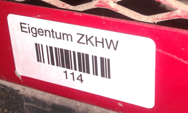
Historical Consultant
The Duffy School
Addition & Renovation
Jeremy Drummond │ Construction Option
Presentation Outline:
I. Introduction
II. Project Overview
III. Analysis #1: rooftop solar panels
IV. Analysis #2: Historical Requirements
Requirements
Historical consultant
Conclusion & Recommendations
V. Analysis #3: prefab exterior Walls
VI. Final Recommendations
VII. Acknowledgements
Issue #2:
Window Procurement
Schedule Delays
Consultant
Issue #3:
Installation Issues
Labeling
Consultant
Taken by Jeremy Drummond
Provided by Keystone Preservation Group
Provided by Gary Gardner Construction
April 14, 2015

Slide 15
Implementation
The Duffy School
Addition & Renovation
Jeremy Drummond │ Construction Option
Presentation Outline:
I. Introduction
II. Project Overview
III. Analysis #1: rooftop solar panels
IV. Analysis #2: Historical Requirements
Requirements
Historical consultant
Conclusion & Recommendations
V. Analysis #3: prefab exterior panels
VI. Final Recommendations
VII. Acknowledgements
Presentation Outline:
I. Introduction
II. Project Overview
III. Analysis #1: rooftop solar panels
IV. Analysis #2: Historical Requirements
Requirements
Historical consultant
Conclusion & Recommendations
V. Analysis #3: prefab exterior Walls
VI. Final Recommendations
VII. Acknowledgements
Final Conclusions:
On-Site Storage Container
Material Procurement
Labeling
Recommendation:
Recommend hiring The Keystone Preservation Group to do historical consulting for The Duffy School.
Schedule Impact:
27 Days
Comparison Summary
Item | Consultant Firm | No Firm
Fee | $35,000 | x
General Conditions | x | $37,000
Schedule | Save 27 Days | x
Total | $35,000 | $37,000
 | Save $2,000
Comparision Summary
Item | Consultant Firm | No Firm
Fee | $35,000 | x
General Conditions | x | $37,000
Schedule | Save 27 Days | x
Total | $35,000 | $37,000
 | Save $2,000
Architectural Breadth
Cost Impact:
+$2,000
April 14, 2015

Slide 16
The Duffy School
Addition & Renovation
Jeremy Drummond │ Construction Option
Presentation Outline:
I. Introduction
II. Project Overview
III. Analysis #1: Virtual Mockups
In-Place vs. Virtual Mockups
Virtual Mockup Development
Virtual Mockup Implementation
Conclusion & Recommendation
IV. Analysis #2: Façade Prefabrication
Current vs. Prefabricated Façade
Mechanical Breadth Analysis
Schedule, Cost & Site Logistics
Conclusion & Recommendations
V. Analysis #3: Revaluating Composite Slab
Lightweight vs. Normal Concrete
Structural Breadth Analysis
Project Impacts
Conclusion & Recommendations
VI. Final Recommendations
VII. Acknowledgements
Presentation Outline:
I. Introduction
II. Project Overview
III. Analysis #1: Rooftop Solar Panels
IV. Analysis #2: Historical Requirements
V. Analysis #3: Prefab Exterior Walls
Current vs. Prefabricated Façade
Panel Design
Panel Implementation
Conclusion & Recommendations
VI. Final Recommendations
VII. Acknowledgements
Analysis #3
Prefabricated Exterior Wall Panels
April 14, 2015

Slide 17
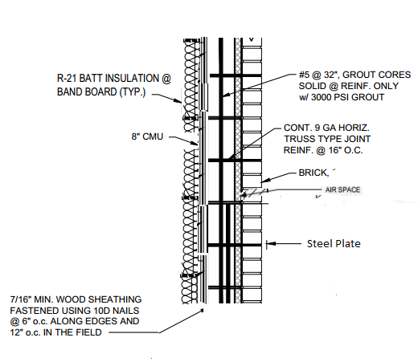
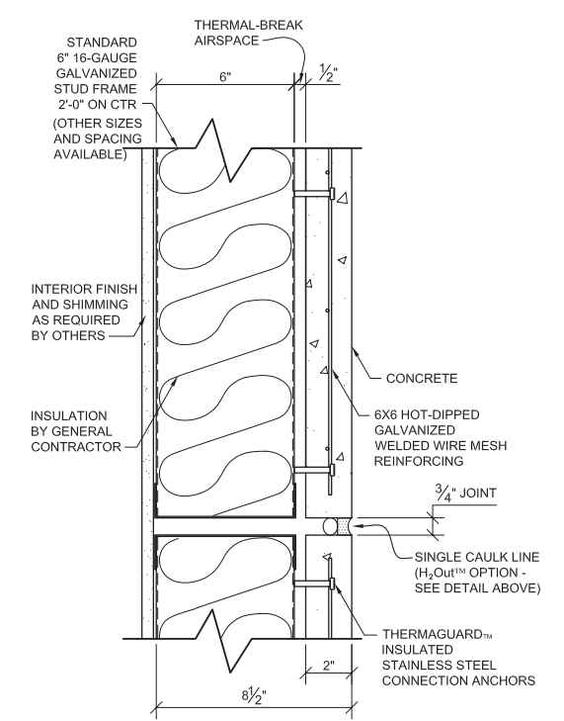
Façade Comparison
The Duffy School
Addition & Renovation
Jeremy Drummond │ Construction Option
Presentation Outline:
I. Introduction
II. Project Overview
III. Analysis #1: Virtual Mockups
In-Place vs. Virtual Mockups
Virtual Mockup Development
Virtual Mockup Implementation
Conclusion & Recommendation
IV. Analysis #2: Façade Prefabrication
Current vs. Prefabricated Façade
Mechanical Breadth Analysis
Schedule, Cost & Site Logistics
Conclusion & Recommendations
V. Analysis #3: Revaluating Composite Slab
Lightweight vs. Normal Concrete
Structural Breadth Analysis
Project Impacts
Conclusion & Recommendations
VI. Final Recommendations
VII. Acknowledgements
Presentation Outline:
I. Introduction
II. Project Overview
III. Analysis #1: Rooftop Solar Panels
IV. Analysis #2: Historical Requirements
V. Analysis #3: Prefab Exterior Walls
Current vs. Prefabricated Façade
Panel Design
Panel Implementation
Conclusion & Recommendations
VI. Final Recommendations
VII. Acknowledgements
Proposed Facade:
9” Insulated Precast Panel
Embedded Thin Brick
Cost = $32/SF
Erection = 8 panels/ day
Opportunity Identification:
Time & Labor Intensive
Site Congestion
Weather Delays
Critical Path
Original Façade:
3.5” Brick on Wood Stud
Cost
Schedule
Research Goals:
Identify alternative panel
Reduce schedule & cost
Reduce site congestion & trade coordination on site
Provided by Gary Gardner Construction
Slenderwall.com
April 14, 2015

Slide 18
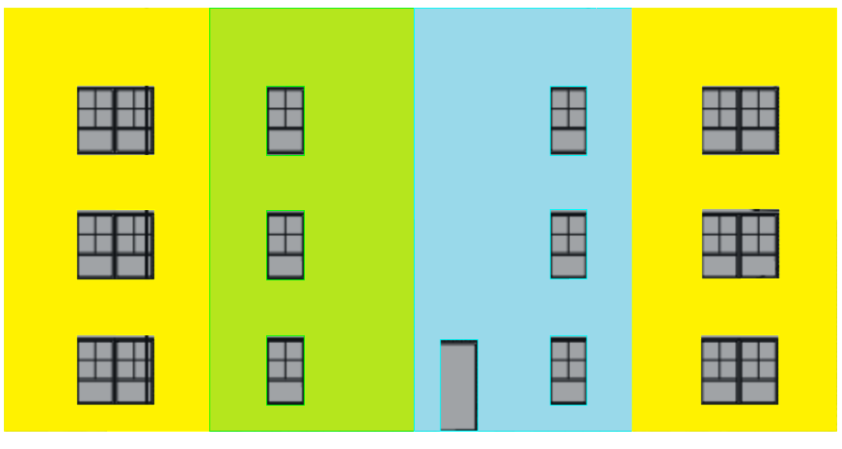
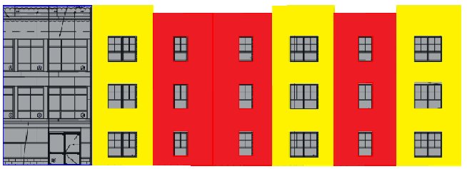
Panel Design
The Duffy School
Addition & Renovation
Jeremy Drummond │ Construction Option
Presentation Outline:
I. Introduction
II. Project Overview
III. Analysis #1: Virtual Mockups
In-Place vs. Virtual Mockups
Virtual Mockup Development
Virtual Mockup Implementation
Conclusion & Recommendation
IV. Analysis #2: Façade Prefabrication
Current vs. Prefabricated Façade
Mechanical Breadth Analysis
Schedule, Cost & Site Logistics
Conclusion & Recommendations
V. Analysis #3: Revaluating Composite Slab
Lightweight vs. Normal Concrete
Structural Breadth Analysis
Project Impacts
Conclusion & Recommendations
VI. Final Recommendations
VII. Acknowledgements
Presentation Outline:
I. Introduction
II. Project Overview
III. Analysis #1: Rooftop Solar Panels
IV. Analysis #2: Historical Requirements
V. Analysis #3: Prefab Exterior Walls
Current vs. Prefabricated Façade
Panel Design
Panel Implementation
Conclusion & Recommendations
VI. Final Recommendations
VII. Acknowledgements
Panel Design:
Consistency & Transportation
Span Building Height
Maximum width 12’
Total 16 precast panels
4 different panel types
North
East
Created by Jeremy Drummond
Created by Jeremy Drummond
Panel Installation Durations
Elevation | Panel QTY. | Duration | Adjusted Duration
South | 6 | .75 Days | 1 Day
North | 6 | .75 Days | 1 Day
East | 4 | .5 Days | .75 Days
Total | 16 | 2 Days | 2.75 Days
South
Created by Jeremy Drummond
April 14, 2015

Slide 19
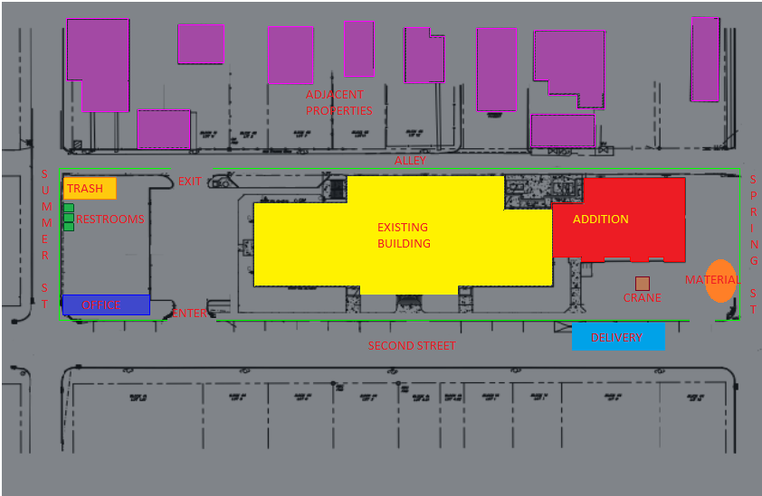
Panel Implementation
The Duffy School
Addition & Renovation
Jeremy Drummond │ Construction Option
Presentation Outline:
I. Introduction
II. Project Overview
III. Analysis #1: Virtual Mockups
In-Place vs. Virtual Mockups
Virtual Mockup Development
Virtual Mockup Implementation
Conclusion & Recommendation
IV. Analysis #2: Façade Prefabrication
Current vs. Prefabricated Façade
Mechanical Breadth Analysis
Schedule, Cost & Site Logistics
Conclusion & Recommendations
V. Analysis #3: Revaluating Composite Slab
Lightweight vs. Normal Concrete
Structural Breadth Analysis
Project Impacts
Conclusion & Recommendations
VI. Final Recommendations
VII. Acknowledgements
Presentation Outline:
I. Introduction
II. Project Overview
III. Analysis #1: Rooftop Solar Panels
IV. Analysis #2: Historical Requirements
V. Analysis #3: Prefab Exterior Walls
Current vs. Prefabricated Façade
Panel Design
Panel Implementation
Conclusion & Recommendations
VI. Final Recommendations
VII. Acknowledgements
Site Layout:
Cost Implications:
Building Enclosure Construction Cost Comparison
Material | Total (SF) | Prefabricated Panels |  | Traditional Brick
 |  | Cost/SF | Total | Cost/SF | Total
Exterior Face Wall | 6,200 | $32.00 | $198,400 | $10.47 | $64,914
Interior Components | 6,200 | $18.73 | $116,126 | $18.73 | $116,126
Insulation | 6,200 | $1.65 | $10,230 | $2.89 | $17,918
Caulking | 1,190 | $2.18 | $2,594.20 | x | X
Transportation | x | Included | Included | x | X
Erection Equipment | x | Included | Included | x | $35,026
Total |  | $54.56 | $327,350 | $32.09 | $233,984
Cost Comparison Summary
Item | Prefabricated Panels Total Cost | Traditional Brick Total Cost
Cost of Assembly | $327,350 | $233,984
General Conditions Cost | $466,630 | $487,156
Total | $793,980 | $721,140
Difference
+ $72,840
Created by Jeremy Drummond
April 14, 2015

Slide 20
Panel Implementation
The Duffy School
Addition & Renovation
Jeremy Drummond │ Construction Option
Presentation Outline:
I. Introduction
II. Project Overview
III. Analysis #1: Rooftop Solar Panels
IV. Analysis #2: Historical Requirements
V. Analysis #3: Prefab Exterior Walls
Current vs. Prefabricated Façade
Panel Design
Panel Implementation
Conclusion & Recommendations
VI. Final Recommendations
VII. Acknowledgements
Final Conclusions:
16 Architectural Precast Panels
Schedule Reduction = 15 Days
Implementation Cost = $72,840
Recommendation:
Not in owner’s best interest to pursue
Increased cost and planning for implementation outweigh savings in schedule and building performance
Cost Implications:
Implement = Additional $6/SF
Interior Components Same
Vapor Barrier, Sheathing & Backup
General Conditions Savings
15 Days = $20,526
Created by Jeremy Drummond
April 14, 2015

Slide 21
Conclusions
The Duffy School
Addition & Renovation
Jeremy Drummond │ Construction Option
Presentation Outline:
I. Introduction
II. Project Overview
III. Analysis #1: Virtual Mockups
In-Place vs. Virtual Mockups
Virtual Mockup Development
Virtual Mockup Implementation
Conclusion & Recommendation
IV. Analysis #2: Façade Prefabrication
Current vs. Prefabricated Façade
Mechanical Breadth Analysis
Schedule, Cost & Site Logistics
Conclusion & Recommendations
V. Analysis #3: Revaluating Composite Slab
Lightweight vs. Normal Concrete
Structural Breadth Analysis
Project Impacts
Conclusion & Recommendations
VI. Final Recommendations
VII. Acknowledgements
Presentation Outline:
I. Introduction
II. Project Overview
III. Analysis #1: Virtual Mockups
IV. Analysis #2: Façade Prefabrication
V. Analysis #3: Revaluating Comp. Slab
VI. Final Recommendations
VII. Acknowledgements
Analysis 1 │ Rooftop solar Panels
Implement Rooftop Solar Panels
Save Cost
Help Occupants
Analysis 2│ Historical Requirements
Would hire an historical consultant firm
Reduced Schedule & Planning
Increased upfront Cost
Analysis 3 │ Prefab Exterior Walls
Would not recommend the prefabrication of the building’s facade
Increased Cost & Planning
Reduced Schedule
Provided by Gary Gardner Construction
April 14, 2015

Slide 22
Acknowledgements
The Duffy School
Addition & Renovation
Jeremy Drummond│ Construction Option
Presentation Outline:
I. Introduction
II. Project Overview
III. Analysis #1: Virtual Mockups
In-Place vs. Virtual Mockups
Virtual Mockup Development
Virtual Mockup Implementation
Conclusion & Recommendation
IV. Analysis #2: Façade Prefabrication
Current vs. Prefabricated Façade
Mechanical Breadth Analysis
Schedule, Cost & Site Logistics
Conclusion & Recommendations
V. Analysis #3: Revaluating Composite Slab
Lightweight vs. Normal Concrete
Structural Breadth Analysis
Project Impacts
Conclusion & Recommendations
VI. Final Recommendations
VII. Acknowledgements
Presentation Outline:
I. Introduction
II. Project Overview
III. Analysis #1: Rooftop solar Panels
IV. Analysis #2: Historical Requirements
V. Analysis #3: Prefab Exterior Walls
VI. Final Recommendations
VII. Acknowledgements
Special Thanks to:
My Family & Friends
Alex Medvesky- Gary F. Gardner
Dominic DeSantis- Gary F. Gardner
Janine Owens- Conifer LLC.
PACE Industry Members
Industry Acknowledgements:
Architectural Engineering Faculty:
Dr. Chimay Anumba (Advisor)
April 14, 2015

Slide 23
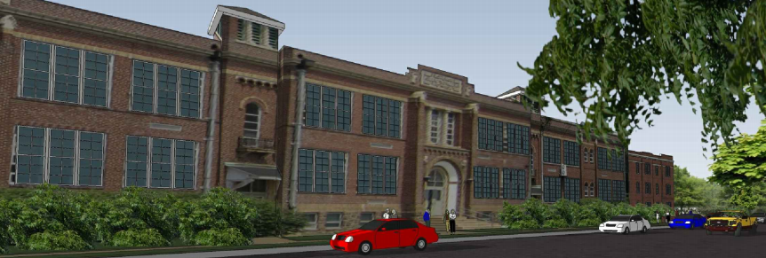
Thank You
The Duffy School
Addition & Renovation
Jeremy Drummond │ Construction Option
Presentation Outline:
I. Introduction
II. Project Overview
III. Analysis #1: Virtual Mockups
In-Place vs. Virtual Mockups
Virtual Mockup Development
Virtual Mockup Implementation
Conclusion & Recommendation
IV. Analysis #2: Façade Prefabrication
Current vs. Prefabricated Façade
Mechanical Breadth Analysis
Schedule, Cost & Site Logistics
Conclusion & Recommendations
V. Analysis #3: Revaluating Composite Slab
Lightweight vs. Normal Concrete
Structural Breadth Analysis
Project Impacts
Conclusion & Recommendations
VI. Final Recommendations
VII. Acknowledgements
Questions & Comments
Provided by Gary Gardner Construction
Provided by Gary Gardner Construction
April 14, 2015

